Slide 1
Data Security and Data Privacy/ Protection LAWS8077 – Cyber Law
Dr Damian Clifford damian.clifford@anu.edu.au

Slide 2
SEMINAR OVERVIEW
Introduction to data privacy/protection and the overlaps with cyber security
A comparative analysis of data protection obligations
APP Entities or controllers and processors and their security obligations
Definition of personal information in the Privacy and its reform
Security of Personal Information
Data protection/privacy impact assessments
Data breach notification obligations
Q&A

Slide 3
INTRODUCTION: DATA PRIVACY/ PROTECTION AND THE OVERLAPS WITH CYBER SECURITY
Positive obligations to protect ‘personal information’ in the Privacy Act.
These are evident in particular in the specific APP principle related to security (APP 11) but see also the data breach notification requirements introduced.

Slide 4
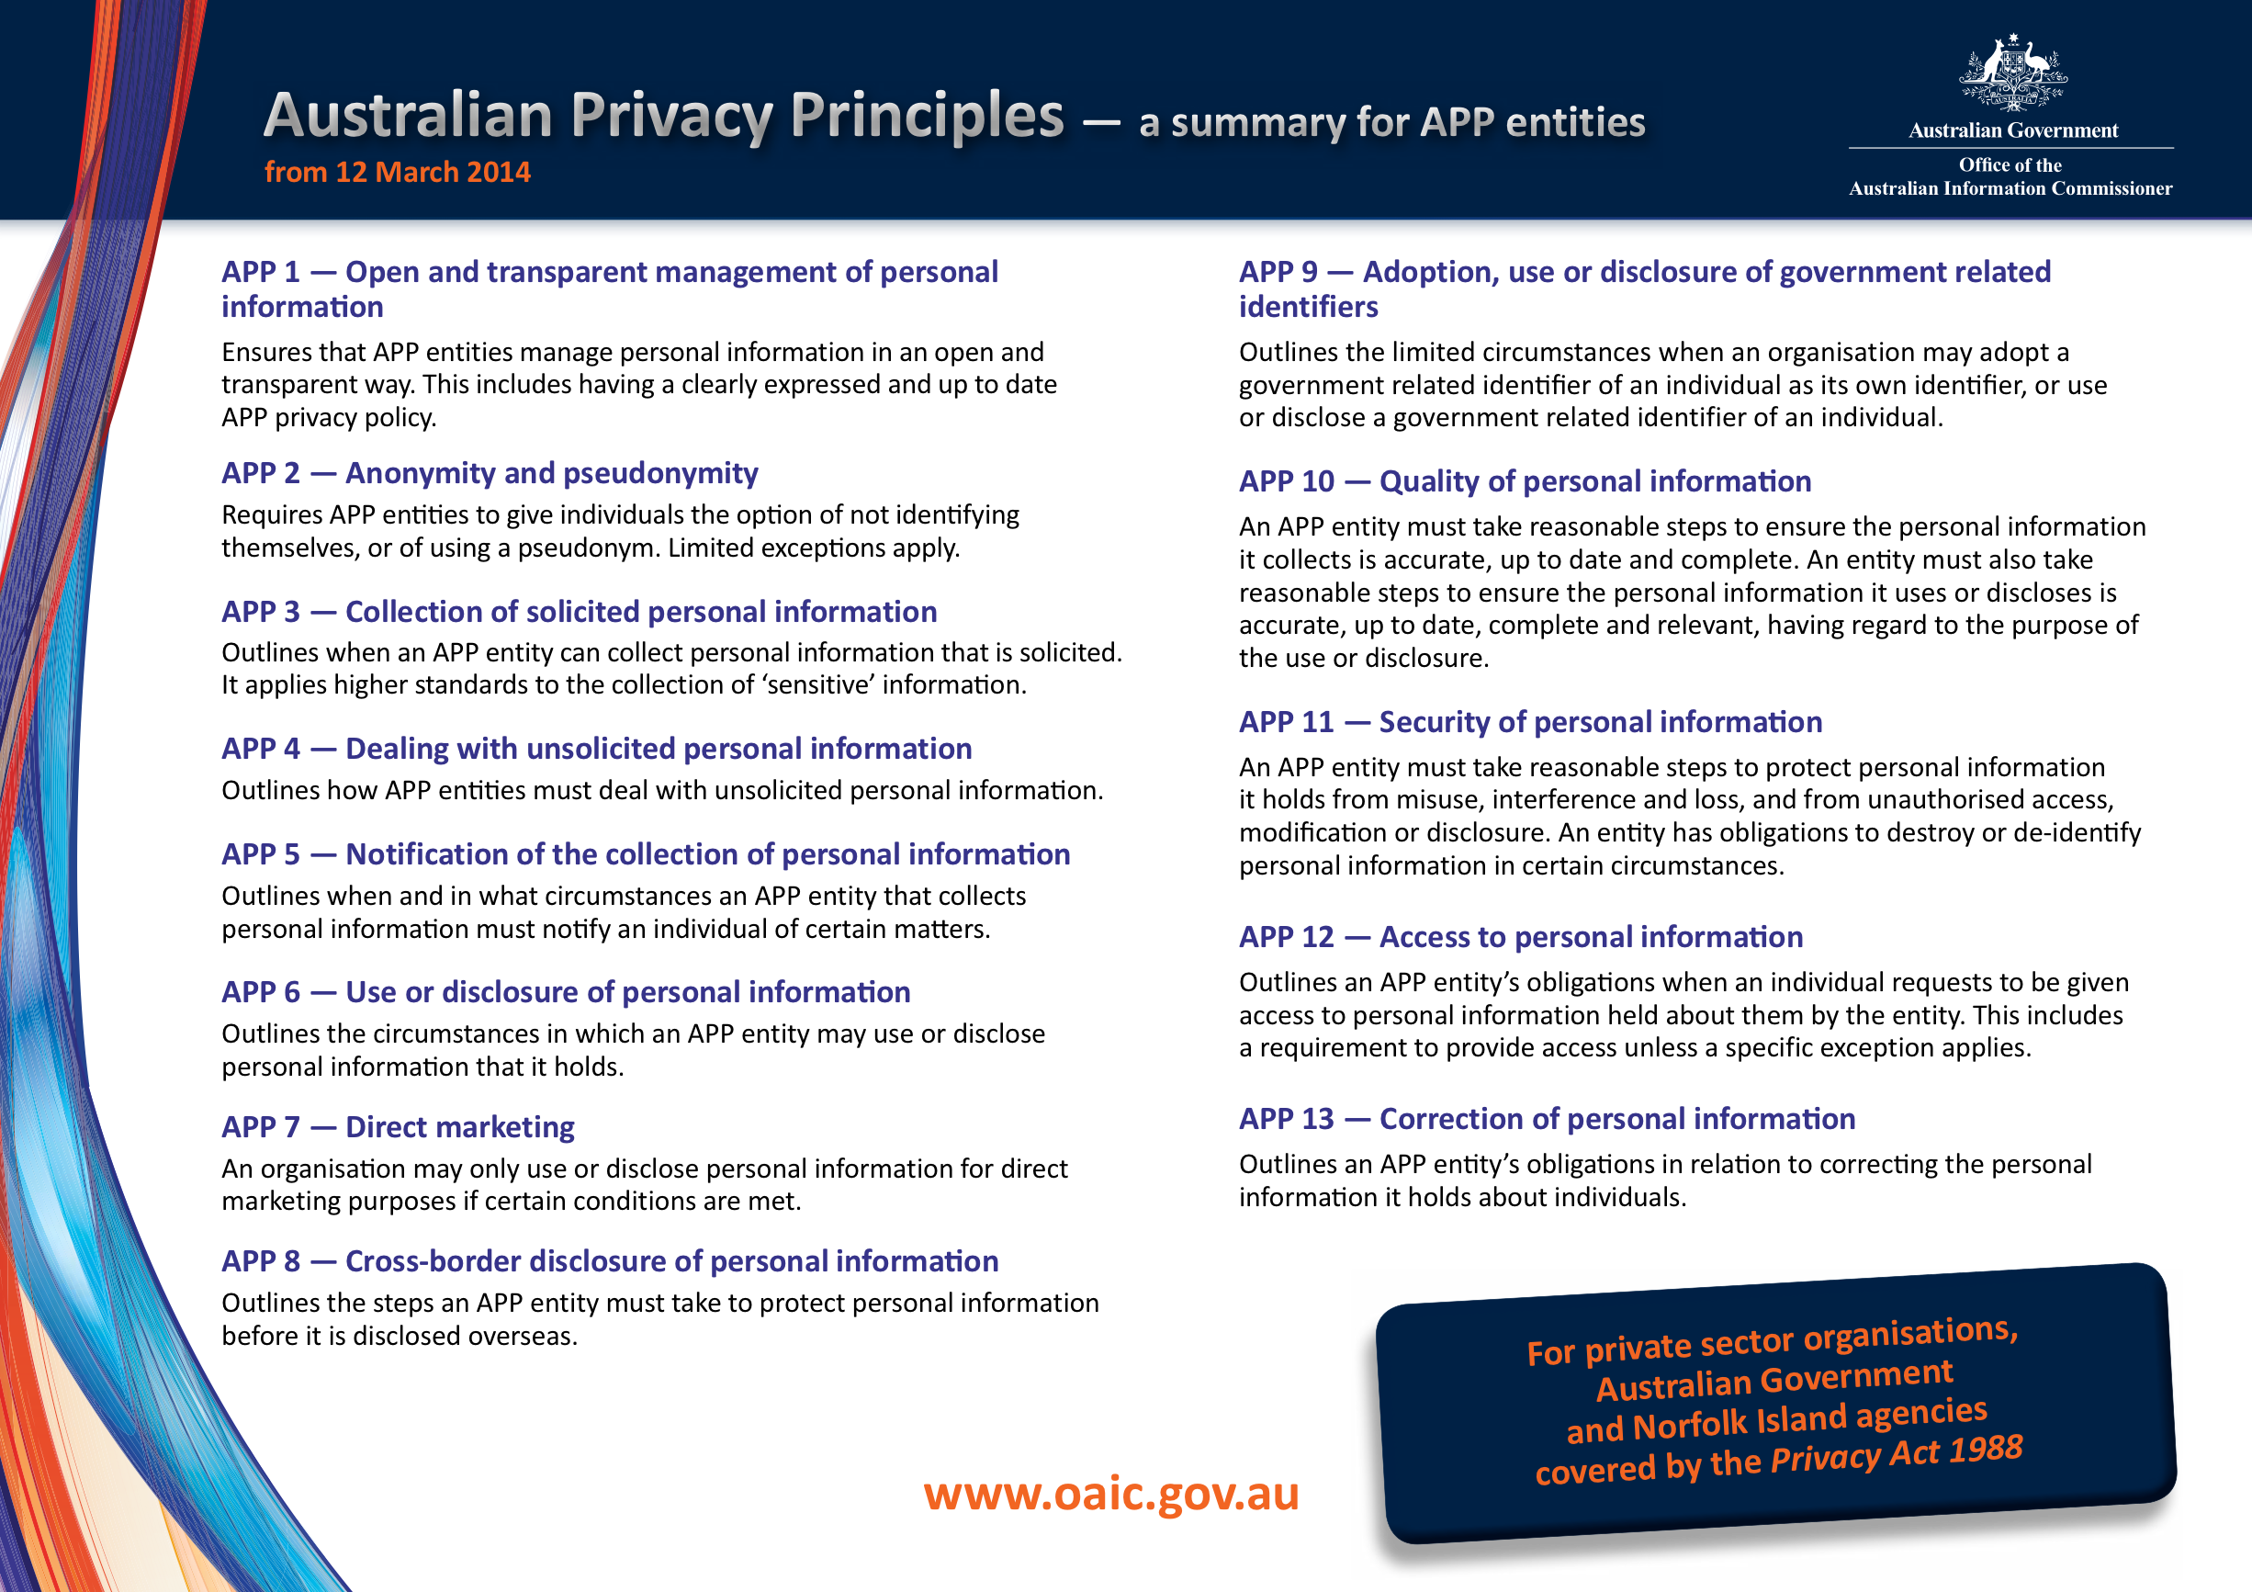

Slide 5
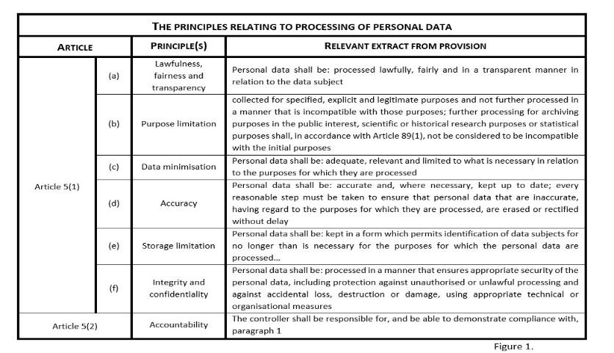

Slide 6
INTRODUCTION: DATA PRIVACY/ PROTECTION AND THE OVERLAPS WITH CYBER SECURITY
Questions are (1) to whom do the obligations in the Privacy Act apply? And (2) what comes within the definition of ‘personal information’?
Important to note however, that (1) the Privacy Act isn’t the only applicable framework (i.e. see here to whom the act applies bit) and (2) it is in the process of review at the moment.

Slide 7

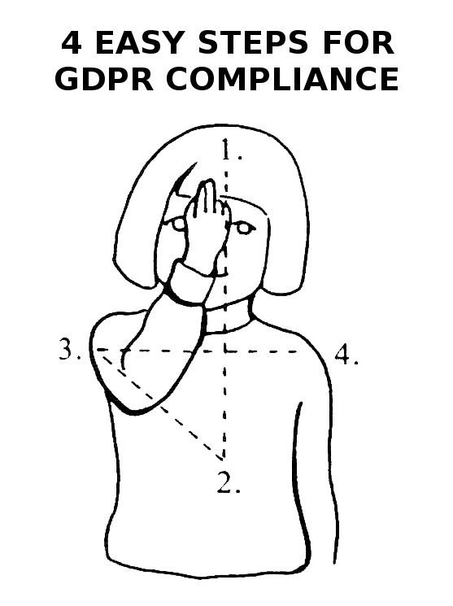
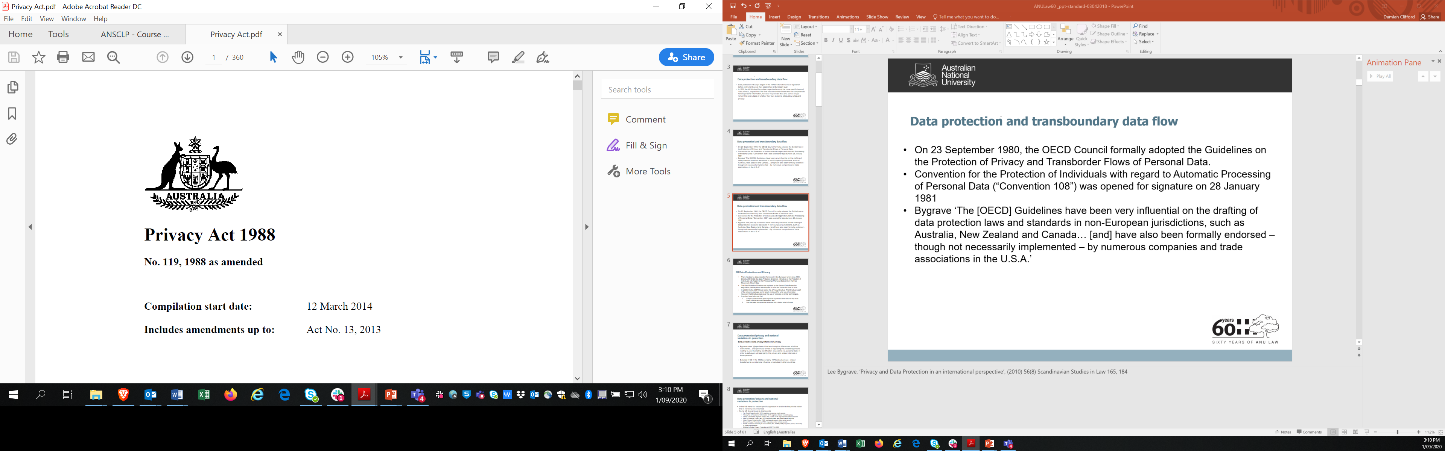
INTRODUCTION: THE PRIVACY ACT AND THE ACCC’S DIGITAL PLATFORM INQUIRY – EU INFLUENCE
Notes:
Lee Bygrave, ‘Privacy and Data Protection in an international perspective’, (2010) 56(8) Scandinavian Studies in Law 165, 184

Slide 8
INTRODUCTION: THE PRIVACY ACT AND THE ACCC’S DIGITAL PLATFORM INQUIRY – EU DP LAW BASICS
There has been a data protection framework in the European Union since 1995 – Directive 95/46/EC (the Data Protection Directive) - Directive on the Protection of Individuals with Regard to the Processing of Personal Data and on the Free Movement of Such Data
The Data Protection Directive was replaced by the General Data Protection Regulation (GDPR) which was adopted in 2016 and came into force in 2018
In addition to the GDPR there is also the ePrivacy Directive. This Directive is part of the telecoms package and is largely irrelevant for what we will consider. However, the Directive does cover the use of ‘cookies’ or similar technologies and there is a specific framework that is part of this package dealing with breach notification requirements.

Slide 9
COMPARATIVE INSIGHTS: APP ENTITIES OR CONTROLLERS AND PROCESSORS
Privacy Act 1988 (Cth)
Australian Privacy Principles regulate the handling of personal information by Commonwealth public sector and much of the private sector
Special rules for tax file numbers
Special rules for credit reporting agencies/credit providers in relation to consumer credit information
Privacy codes
Functions and powers of Australian Information Commissioner (Privacy Commissioner)

Slide 10
COMPARATIVE INSIGHTS: APP ENTITIES OR CONTROLLERS AND PROCESSORS
Federal Legislation | Federal Sector Specific Legislation | State Level Legislation
Privacy Act 1988 | Telecommunications (Interception and Access) Act 1979 Telecommunications (Interception and Access) Amendment (Data Retention) Act 2015 | Victoria: Health Records Act 2001, Privacy and Data Protection Act 2014, ACT: Health Records (Privacy and Access) Act 1997; NSW: Health Records and Information Privacy Act 2002, Privacy and Personal Information Protection 1998,
Australian Consumer Law | Spam Act 2003 | NT: Information Act 2002, Tasmania: Personal Information Protection Act 2004, QL: Information Privacy Act 2009
 | My Health Records Act 2012 | Victoria: Surveillance Devices Act 1999, NSW: Surveillance Devices Act 2007, Workplace Surveillance Act 2005 Victoria: Crimes Act eg, assault, s 21A (stalking) Summary Offences Act s. 41DA (sexting)

Slide 11
COMPARATIVE INSIGHTS: APP ENTITIES OR CONTROLLERS AND PROCESSORS
Privacy Act 1988 (Cth): private sector application
Private sector regime
Applies to all ‘organisations’ with annual turnover of greater than $3 mil unless ‘at risk’ or health service provider
Exemptions including acts relating to journalism, media, employee records, political parties, emergencies, personal, family or household affairs.
Establishes co-regulatory regime (privacy codes)

Slide 12
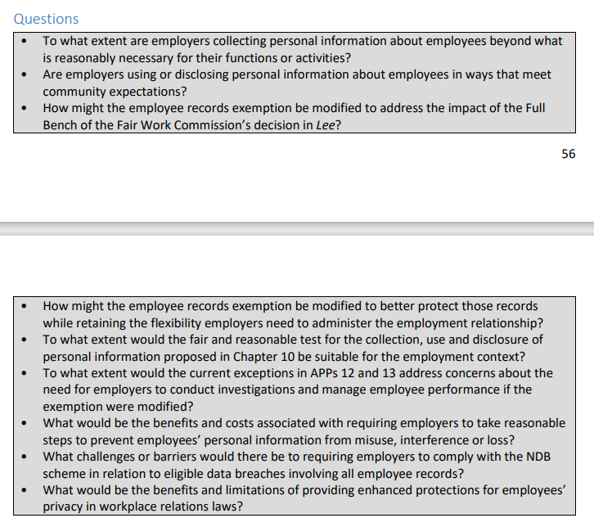
COMPARATIVE INSIGHTS: APP ENTITIES OR CONTROLLERS AND PROCESSORS
Privacy Act 1988 (Cth): private sector application
Private sector regime
This means that the security requirements in APP 11 for instance do not apply.
In its comprehensive review of the laws the Australian Law Reform Commission advocated for the removal of the small business exemption (ALRC 2008) and this suggestion for reform was repeated in the ACCC report.
The Full Bench of the Fair Work Commission in Lee v Superior Wood held that the exemption did not apply to the employer’s collection of sensitive information because the information was not yet contained in an employee record. Employers must therefore comply with APP 3 when collecting an employee’s personal information before including it in their employee record. This requires obtaining the employee’s consent in order to collect sensitive information.

Slide 13
COMPARATIVE INSIGHTS: APP ENTITIES OR CONTROLLERS AND PROCESSORS
A controller is defined in Article 4(7) GDPR.
The natural or legal person ‘which, alone or jointly with others, determines the purposes and means of the processing of personal data’.
Article 4(8) GDPR defines a processor.
Any natural or legal person ‘which processes personal data on behalf of the controller’
Article 26(1) clarifies what is meant by ‘joint controllers’
‘Where two or more controllers jointly determine the purposes and means of processing, they shall be joint controllers. They shall in a transparent manner determine their respective responsibilities for compliance with the obligations under this Regulation, in particular as regards the exercising of the rights of the data subject and their respective duties to provide the information referred to in Articles 13 and 14, by means of an arrangement between them unless, and in so far as, the respective responsibilities of the controllers are determined by Union or Member State law to which the controllers are subject. The arrangement may designate a contact point for data subjects.

Slide 14
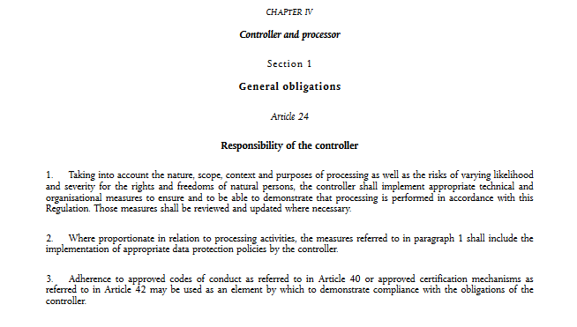
COMPARATIVE INSIGHTS: APP ENTITIES OR CONTROLLERS AND PROCESSORS

Slide 15
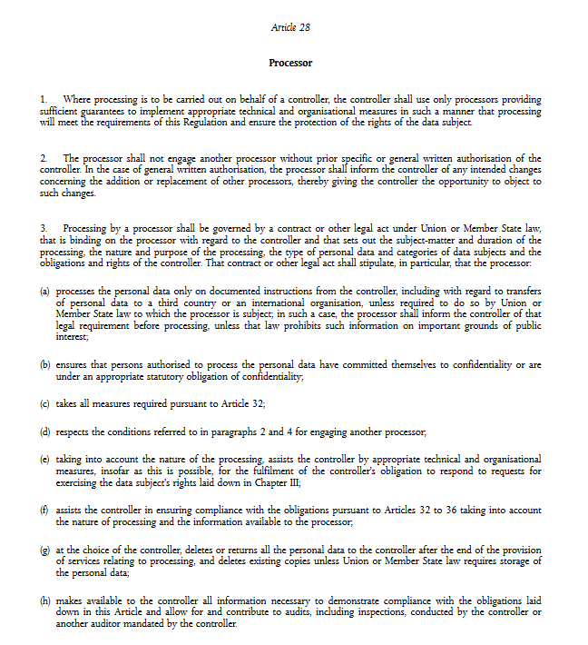
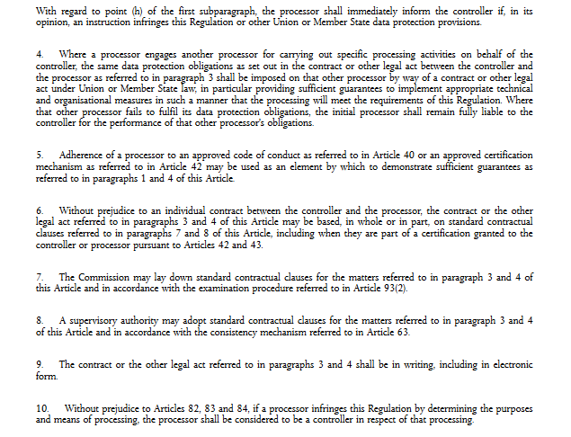
COMPARATIVE INSIGHTS: APP ENTITIES OR CONTROLLERS AND PROCESSORS

Slide 16
Which is the best approach?

Slide 17
COMPARATIVE INSIGHTS: PERSONAL INFORMATION
What is personal information?
personal information means information or an opinion about an identified individual, or an individual who is reasonably identifiable:
(a) whether the information or opinion is true or not; and
(b) whether the information or opinion is recorded in a material form or not.

Slide 18
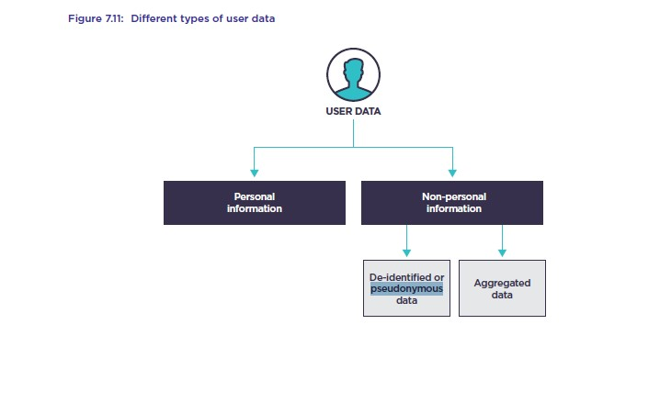
COMPARATIVE INSIGHTS: PERSONAL INFORMATION
APP2. Anonymity and Pseudonymity
2.1 – Individuals must have the option of
(1) not identifying themselves, or
(2) using a pseudonym, when dealing with an APP entity in relation to a particular matter.
2.2 – Subclause 2.1 does not apply if, in relation to that matter:
APP 2.2(a) – The APP entity is required or authorised by or under an Australian law, or a court/tribunal order, to deal with individuals who have identified themselves, or
APP 2.2(b) – It is impracticable for the APP entity to deal with individuals who have not identified themselves or used a pseudonym
Notes:
Australian Competition and Consumer Commission (ACCC), Digital Platforms Inquiry, Final Report, Canberra (2019); Australian Government, Regulating in the Digital Age: Government Response and Implementation Roadmap for the Digital Platforms Inquiry, Canberra (12 December 2019) <https://treasury.gov.au/publication/p2019-41708>; Australian Government, Attorney-General’s Department, Privacy Act Review, Issues Paper, Canberra (October 2020) (‘Issues Paper’)

Slide 19
COMPARATIVE INSIGHTS: PERSONAL INFORMATION v GDPR PERSONAL DATA
Article 2(1). ‘This Regulation applies to the processing of personal data wholly or partly by automated means and to the processing other than by automated means of personal data which form part of a filing system or are intended to form part of a filing system.’
‘Processing’ is broadly defined in Article 4(2) GDPR as,
‘[…] any operation or set of operations which is performed on personal data or on sets of personal data, whether or not by automated means, such as collection, recording, organisation, structuring, storage, adaptation or alteration, retrieval, consultation, use, disclosure by transmission, dissemination or otherwise making available, alignment or combination, restriction, erasure or destruction’.
Personal data are defined in Article 4(1) GDPR as,
‘[…] any information relating to an identified or identifiable natural person (‘data subject’); an identifiable natural person is one who can be identified, directly or indirectly, in particular by reference to an identifier such as a name, an identification number, location data, an online identifier or to one or more factors specific to the physical, physiological, genetic, mental, economic, cultural or social identity of that natural person.’

Slide 20
COMPARATIVE INSIGHTS: PERSONAL INFORMATION v GDPR PERSONAL DATA
Article 4(1). ‘[…] any information relating to an identified or identifiable natural person (‘data subject’);
Article 29 Data Protection Working Party, ‘Opinion 4/2007 on the Concept of Personal Data WP 136’ (2007)
Cumulative elements.
Opinion largely endorsed by the Court of Justice in its case law
Case C-582/14, Breyer, ECLI: EU:C:2016:779. - identified or identifiable
Joint cases C-141/12 and C- 372/12, YS and M. and S. v Minister of Immigration, Integration and Asylum [2016], ECLI:EU:C:2014:2081. relating to
C‑434/16, Peter Nowak v Data Protection Commissioner, ECLI:EU:C:2017:994. relating to ‘[…] is satisfied where the information, by reason of its content, purpose or effect, is linked to a particular person.’ [35] (Emphasis added).

Slide 21
COMPARATIVE INSIGHTS: PERSONAL INFORMATION v GDPR PERSONAL DATA
Article 2(1) GDPR. ‘This Regulation applies to the processing of personal data wholly or partly by automated means and to the processing other than by automated means of personal data which form part of a filing system or are intended to form part of a filing system.’
Personal data are defined in Article 4(1) GDPR as,
‘[…] any information relating to an identified or identifiable natural person (‘data subject’); an identifiable natural person is one who can be identified, directly or indirectly, in particular by reference to an identifier such as a name, an identification number, location data, an online identifier or to one or more factors specific to the physical, physiological, genetic, mental, economic, cultural or social identity of that natural person.’
Part II — Interpretation Division 1 — General Definitions — 6 Interpretation. Personal information is defined as ‘information or an opinion about an identified individual, or an individual who is reasonably identifiable: (a) whether the information or opinion is true or not; and (b) whether the information or opinion is recorded in a material form or not.’
In Privacy Commissioner v Telstra (2017) the Full Federal Court accepted a definition which required a closer link between the information and the individual than is required under European law
Notes:
‘Processing’ is broadly defined in Article 4(2) GDPR as,
‘[…] any operation or set of operations which is performed on personal data or on sets of personal data, whether or not by automated means, such as collection, recording, organisation, structuring, storage, adaptation or alteration, retrieval, consultation, use, disclosure by transmission, dissemination or otherwise making available, alignment or combination, restriction, erasure or destruction’.

Slide 22
COMPARATIVE INSIGHTS: PERSONAL INFORMATION v GDPR PERSONAL DATA
Article 4(1). ‘[…] an identifiable natural person is one who can be identified, directly or indirectly, in particular by reference to an identifier such as a name, an identification number, location data, an online identifier or to one or more factors specific to the physical, physiological, genetic, mental, economic, cultural or social identity of that natural person.’
‘[P]seudonymisation’ is defined in Article 4(5) GDPR to mean,
‘[…] the processing of personal data in such a manner that the personal data can no longer be attributed to a specific data subject without the use of additional information, provided that such additional information is kept separately and is subject to technical and organisational measures to ensure that the personal data are not attributed to an identified or identifiable natural person’.
Recital 26 GDPR specifies that in order to determine whether a natural person is identifiable,
‘[…] account should be taken of all the means reasonably likely to be used, such as singling out, either by the controller or by another person to identify the natural person directly or indirectly. To ascertain whether means are reasonably likely to be used to identify the natural person, account should be taken of all objective factors, such as the costs of and the amount of time required for identification, taking into consideration the available technology at the time of the processing and technological developments.’ See: Case C-582/14, Breyer, ECLI: EU:C:2016:779.

Slide 23
COMPARATIVE INSIGHTS: PERSONAL INFORMATION AND THE ACCC REPORT
California Consumer Privacy Act 2019 (ss 1798.140 (o))
(1) “Personal information” means information that identifies, relates to, describes, is reasonably capable of being associated with, or could reasonably be linked, directly or indirectly, with a particular consumer or household. Personal information includes, but is not limited to, the following if it identifies, relates to, describes, is reasonably capable of being associated with, or could be reasonably linked, directly or indirectly, with a particular consumer or household:
(A) Identifiers such as a real name, alias, postal address, unique personal identifier, online identifier, internet protocol address, email address, account name, social security number, driver’s license number, passport number, or other similar identifiers.

Slide 24
COMPARATIVE INSIGHTS: PERSONAL INFORMATION AND THE ACCC REPORT
California Consumer Privacy Act 2019 (ss 1798.140 (o))
“Deidentified” means information that cannot reasonably identify, relate to, describe, be capable of being associated with, or be linked, directly or indirectly, to a particular consumer, provided that a business that uses deidentified information:
(1) Has implemented technical safeguards that prohibit reidentification of the consumer to whom the information may pertain.
(2) Has implemented business processes that specifically prohibit reidentification of the information.
(3) Has implemented business processes to prevent inadvertent release of deidentified information.
(4) Makes no attempt to reidentify the information.

Slide 25
COMPARATIVE INSIGHTS: PERSONAL INFORMATION AND THE ACCC REPORT
Recommendation 16: Strengthen protections in the Privacy Act
16(a) Update ‘personal information’ definition
16(b) Strengthen notification requirements
16(c) Strengthen consent requirements and pro-consumer defaults
16(d) Enable the erasure of personal information
16(e) Introduce direct rights of action for individuals
16(f) Higher penalties for breach of the Privacy Act
Recommendation 17: Broader reform of Australian privacy law
Recommendation 18: OAIC privacy code for digital platforms
Recommendation 19: Statutory tort for serious invasions of privacy

Slide 26
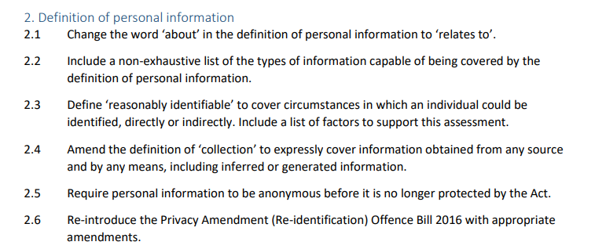
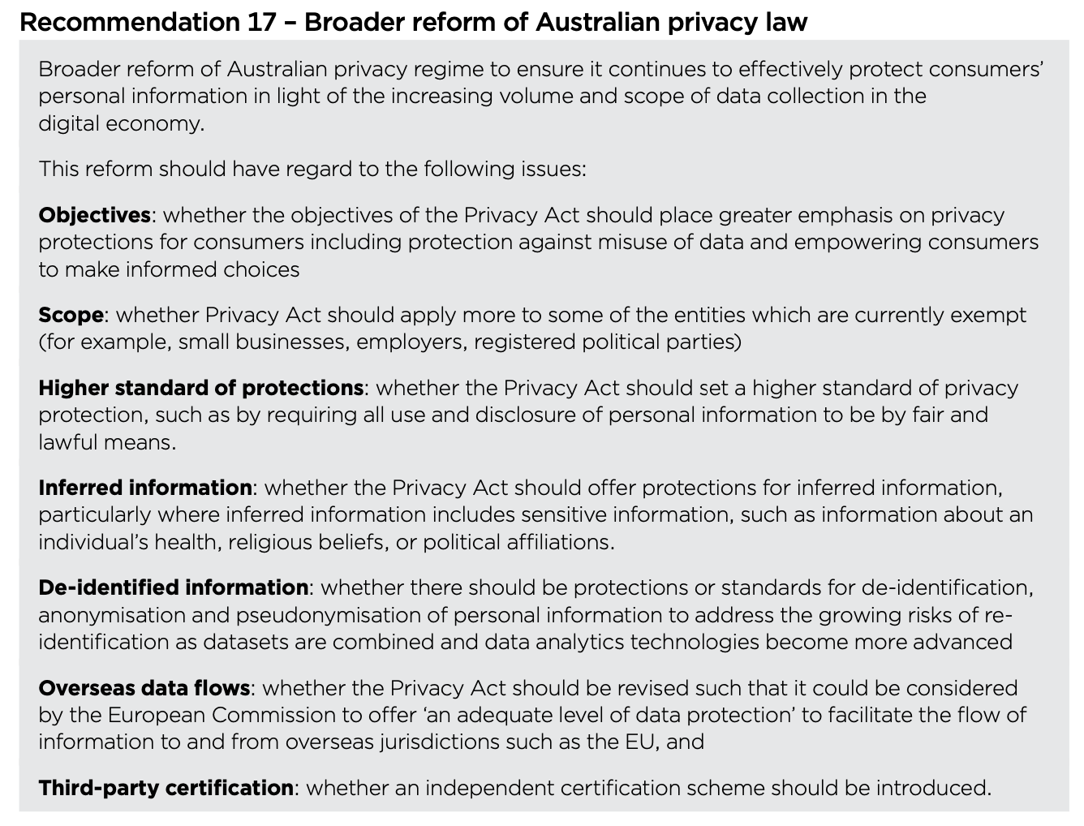
COMPARATIVE INSIGHTS: PERSONAL INFORMATION AND THE ACCC REPORT

Slide 27
Should we reform the definition of personal information in Australia?

Slide 28
COMPARATIVE INSIGHTS: SENSITIVE PERSONAL INFORMATION
Section 6 of the Privacy Act – The Act states that sensitive information means: (a) information or an opinion about an individual’s: (i) racial or ethnic origin; or (ii) political opinions; or (iii) membership of a political association; or (iv) religious beliefs or affiliations; or (v) philosophical beliefs; or (vi) membership of a professional or trade association; or (vii) membership of a trade union; or (viii) sexual orientation or practices; or (ix) criminal record; that is also personal information; or (b) health information about an individual; or (c) genetic information about an individual that is not otherwise health information; or (d) biometric information that is to be used for the purpose of automated biometric verification or biometric identification; or (e) biometric templates.
Article 9(1) GDPR – ‘[p]rocessing of personal data revealing racial or ethnic origin, political opinions, religious or philosophical beliefs, or trade union membership, and the processing of genetic data, biometric data for the purpose of uniquely identifying a natural person, data concerning health or data concerning a natural person's sex life or sexual orientation shall be prohibited.’

Slide 29
COMPARATIVE INSIGHTS: SENSITIVE PERSONAL INFORMATION AND THE ACCC REPORT
Recommendation 16: Strengthen protections in the Privacy Act
16(a) Update ‘personal information’ definition
16(b) Strengthen notification requirements
16(c) Strengthen consent requirements and pro-consumer defaults
16(d) Enable the erasure of personal information
16(e) Introduce direct rights of action for individuals
16(f) Higher penalties for breach of the Privacy Act
Recommendation 17: Broader reform of Australian privacy law
Recommendation 18: OAIC privacy code for digital platforms
Recommendation 19: Statutory tort for serious invasions of privacy

Slide 30
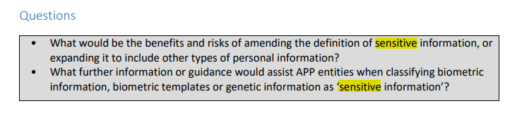
COMPARATIVE INSIGHTS: SENSITIVE PERSONAL INFORMATION AND THE ACCC REPORT

Slide 31
COMPARATIVE INSIGHTS: SENSITIVE PERSONAL INFORMATION AND OTHERS
Influence |  | Jurisdiction | Sensitive category | No sensitive category
Convention for the Protection of Individuals with regard to Automatic Processing of Personal Data (“Convention 108”) | EU: Directive 95/46/EC and the GDPR | Ireland | X
 |  | UK | X
 |  | Australia | X
OECD Guidelines on the Protection of Privacy and Transborder Flows of Personal Data |  | Canada |  | X
 |  | New Zealand |  | X
 |  | Singapore |  | X
 |  | US | ?

Slide 32
Do you agree with having stricter protections for certain categories of information?

Slide 33
COMPARATIVE INSIGHTS: SECURITY OF PERSONAL INFORMATION
APP 11.1 – An APP entity that holds personal information must take reasonable steps to protect the information from misuse, interference and loss, as well as unauthorised access, modification or disclosure.
APP 11.2 – An APP entity must take reasonable steps to destroy or de-identify the personal information it holds once the personal information is no longer needed for any purpose for which the personal information may be used or disclosed under the APPs. This requirement does not apply where the personal information is contained in a Commonwealth record or where the entity is required by law or a court/tribunal order to retain the personal information.

Slide 34
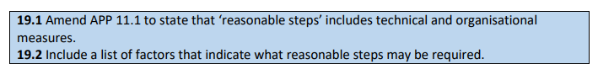
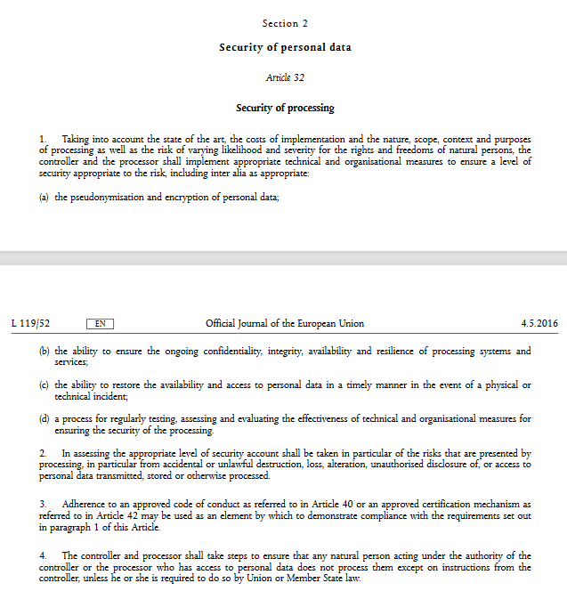
COMPARATIVE INSIGHTS: SECURITY OF PERSONAL INFORMATION

Slide 35
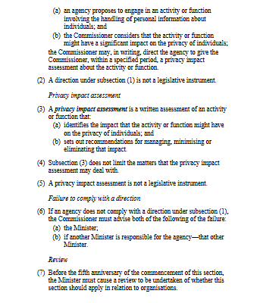
COMPARATIVE INSIGHTS: DP/PRIVACY IMPACT ASSESSMENT
Section 33D Commissioner may direct an agency to give a privacy impact assessment.
Agency means that this AIC power is limited in that it is directed to the public sector.
Needs to be ‘significant impact on privacy’.
Defines a PIA.

Slide 36
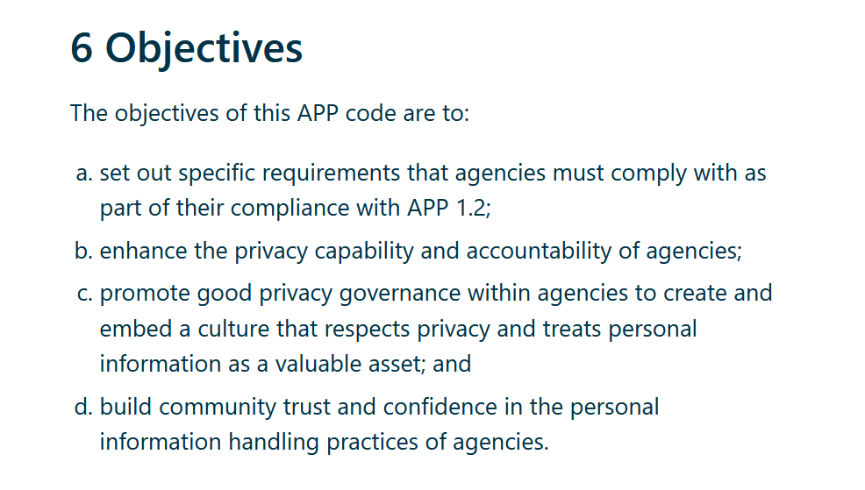
COMPARATIVE INSIGHTS: DP/PRIVACY IMPACT ASSESSMENT
Privacy (Australian Government Agencies – Governance) APP Code 2017
Developed under section 26G of the Privacy Act 1988 and commenced on 1 July 2018

Slide 37
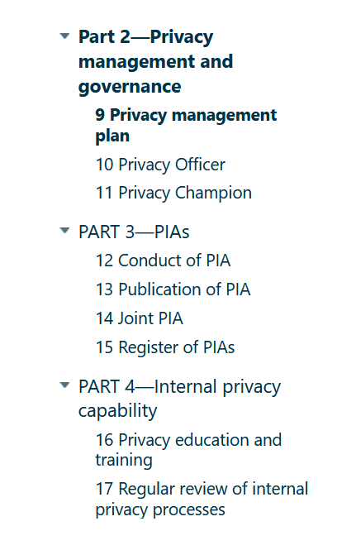
COMPARATIVE INSIGHTS: DP/PRIVACY IMPACT ASSESSMENT
Privacy (Australian Government Agencies – Governance) APP Code 2017

Slide 38
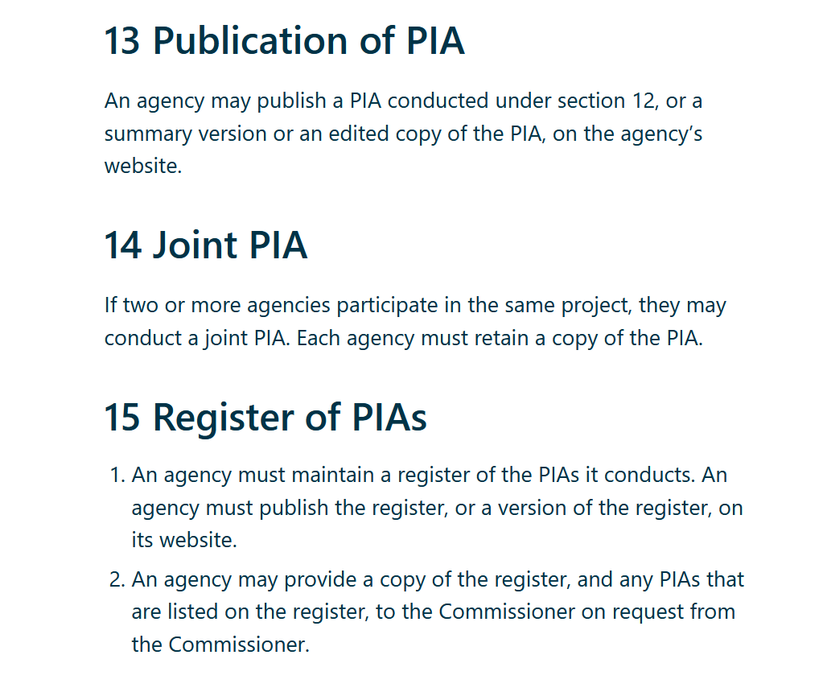
COMPARATIVE INSIGHTS: DP/PRIVACY IMPACT ASSESSMENT
Privacy (Australian Government Agencies – Governance) APP Code 2017
PIA for all high privacy risk projects.
PART 3.12(2) – ‘For the purposes of this section, a project may be a high privacy risk project if the agency reasonably considers that the project involves any new or changed ways of handling personal information that are likely to have a significant impact on the privacy of individuals.’

Slide 39
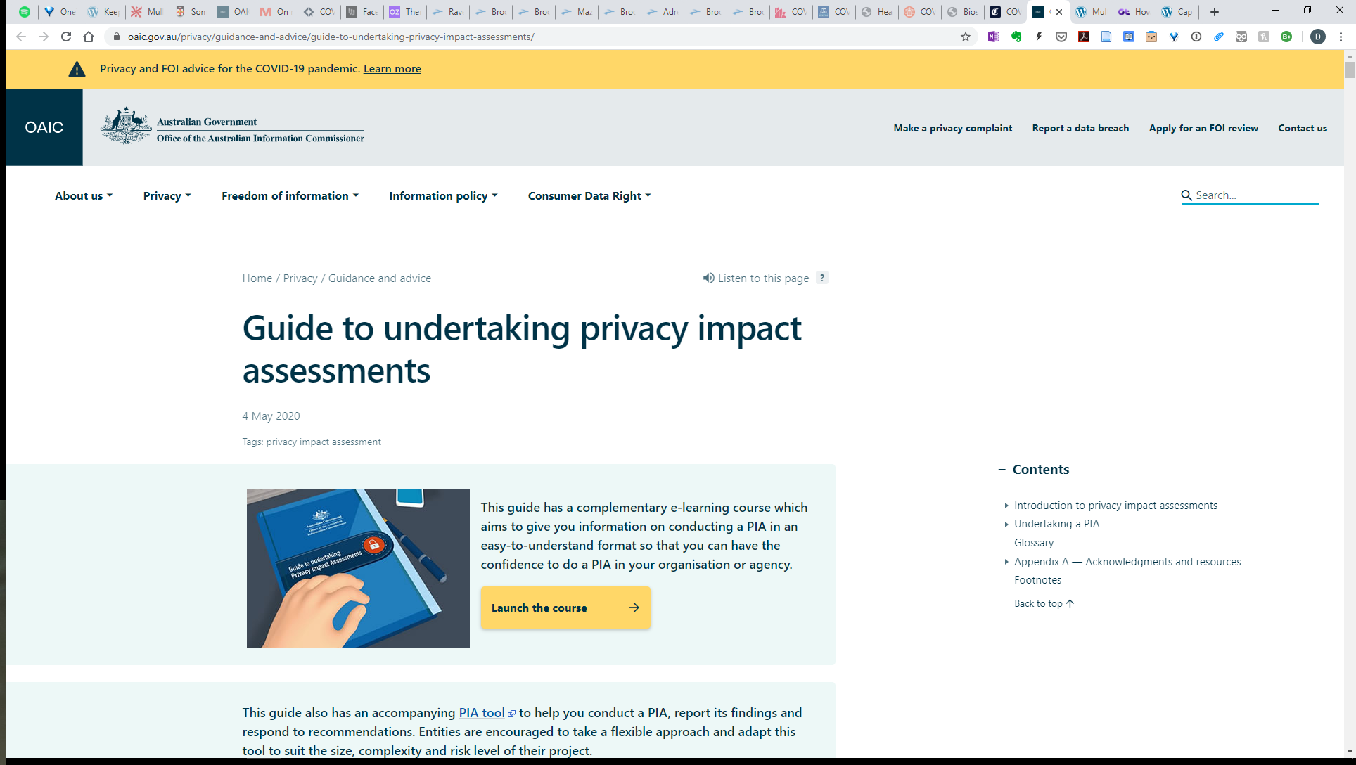
COMPARATIVE INSIGHTS: DP/PRIVACY IMPACT ASSESSMENT
Privacy (Australian Government Agencies – Governance) APP Code 2017
PIA for all high privacy risk projects.

Slide 40
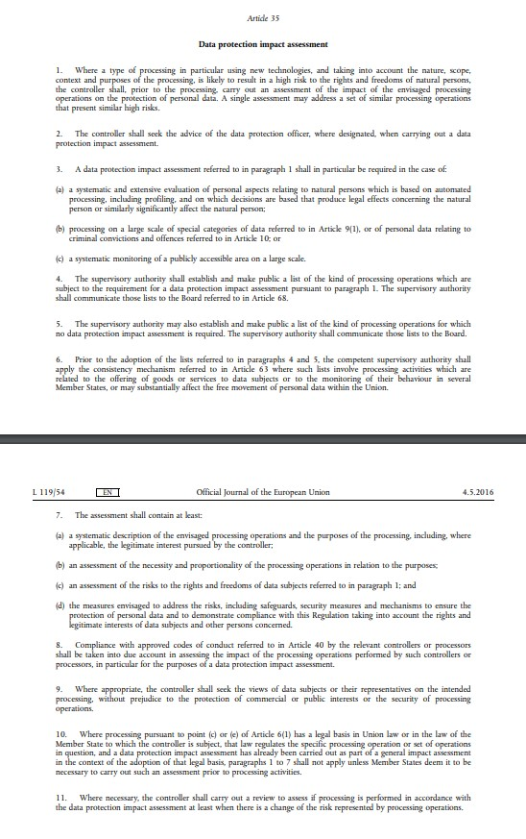
COMPARATIVE INSIGHTS: DP/PRIVACY IMPACT ASSESSMENT
The requirement to conduct a DPIA in the GDPR
In the determination of what is meant by ‘high risk’ in Article 35(1) where a failure to conduct a DPIA properly (or indeed at all) would seemingly breach the fairness principle.
In the interpretation of the situations identified as being specific cases of high risk in Article 35(3).
In the content of a DPIA including the items listed in Article 35(7) and for example, the assessment of the proportionality and necessity of the processing operations, required under Article 35(7)(b).

Slide 41
COMPARATIVE INSIGHTS: DATA BREACHES AND NOTIFICATION REQUIREMENTS
There are practical purposes to data breach notification obligations (i.e. people can take steps to mitigate potential harms e.g. identity fraud).
However, such schemes also take a broader perspective in terms of the enhancement of accountability for protecting privacy thereby aiming to build trust.

Slide 42
COMPARATIVE INSIGHTS: DATA BREACHES AND NOTIFICATION REQUIREMENTS
The Notifiable Data Breaches (NDB) scheme – Privacy Act
Part IIIC of the Privacy Act requires entities to notify (affected individuals and the Commissioner) about ‘eligible data breaches’.
An eligible data breach occurs when the following criteria are met:
There is unauthorised access to or disclosure of personal information held by an entity (or information is lost in circumstances where unauthorised access or disclosure is likely to occur).
This is likely to result in serious harm to any of the individuals to whom the information relates.
The entity has been unable to prevent the likely risk of serious harm with remedial action.
Entities must also conduct an assessment if it is not clear if a suspected data breach meets these criteria. The assessment will determine whether the breach is an ‘eligible data breach’ that triggers notification obligations.

Slide 43
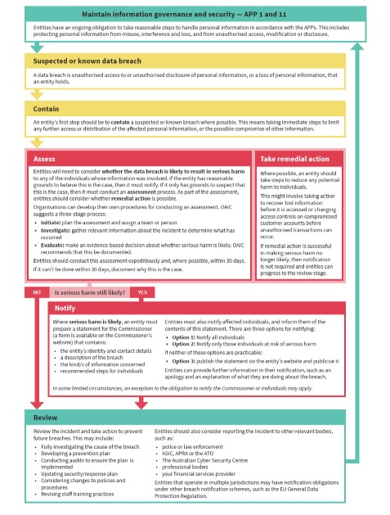
COMPARATIVE INSIGHTS: DATA BREACHES AND NOTIFICATION REQUIREMENTS
The Notifiable Data Breaches (NDB) scheme – Privacy Act
Step 1: Contain the data breach to prevent any further compromise of personal information.
Step 2: Assess the data breach by gathering the facts and evaluating the risks, including potential harm to affected individuals and, where possible, taking action to remediate any risk of harm.
Step 3: Notify individuals and the Commissioner if required. If the breach is an ‘eligible data breach’ under the NDB scheme, it may be mandatory for the entity to notify.
Step 4: Review the incident and consider what actions can be taken to prevent future breaches.
An entity must take all reasonable steps to complete the assessment within 30 calendar days after the day the entity became aware of the grounds (or information) that caused it to suspect an eligible data breach (s 26WH(2)).

Slide 44
COMPARATIVE INSIGHTS: DATA BREACH NOTIFICATION AND THE GDPR
The Data Protection Directive 95/46/EC did not include a specific data breach notification obligation. However, obligations of this kind were often included in national law or the Data Protection Authorities recommended it, by inferring good practice standards to notify from other provisions of the Directive.
In contrast, the GDPR does include a notification obligation in case of a personal data breach in Art. 33 GDPR.
The controller is required to provide notification of the personal data breach without undue delay and, where feasible, no later than 72 hours after having become aware of it (if the notification is made later, reasons for the delay must be given).
Where a data processor becomes aware of a personal data breach, this entity is obligated to notify the controller without undue delay who in turn must notify the supervisory authority.

Slide 45
COMPARATIVE INSIGHTS: DATA BREACHES NOTIFICATION AND THE GDPR
This provision does not focus on the impact of the service to trigger a notification obligation. Instead, breaches must be notified in general with the exception of a personal data breach that is unlikely to result in a risk to the rights and freedoms of natural persons.
In situations where the personal data breach is likely to result in a high risk to the rights and freedoms of natural persons, the controller is required to inform not only the supervisory authority but also the data subject without undue delay.

Slide 46
COMPARATIVE INSIGHTS: DATA BREACH NOTIFICATION AND THE GDPR
Some substantive differences between the jurisdictions
Scope of application given the differences between the definition of personal data and personal information.
Scope of application given the differences between APP Entities versus controller and processor.
72 hours to notify the relevant data protection authority versus 30 days to complete the assessment to determine if it was an eligible data breach.
Obligation to report irrespective of seriousness unlikely to result in a risk to the rights and freedoms of natural persons in the GDPR whereas it is for the APP Entity to determine whether the breach is eligible.

Slide 47
COMPARATIVE INSIGHTS: DATA BREACHES AND NOTIFICATION REQUIRMENTS
Other reporting obligations – Australia
For data breaches affecting certain categories of information, other mandatory or voluntary reporting schemes may exist. For example, entities might consider reporting certain breaches to:
the entity’s financial services provider
police or law enforcement bodies
the Australian Securities & Investments Commission (ASIC)
the Australian Prudential Regulation Authority (APRA)
the Australian Taxation Office (ATO)
the Australian Transaction Reports and Analysis Centre (AUSTRAC)
the Australian Cyber Security Centre (ACSC)
the Australian Digital Health Agency (ADHA)
the Department of Health
State or Territory Privacy and Information Commissioners
Professional associations and regulatory bodies
Insurance providers

Slide 48
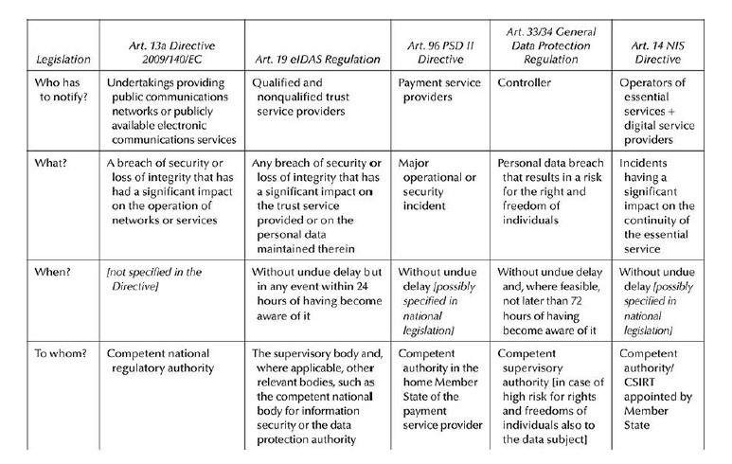
COMPARATIVE INSIGHTS: DATA BREACHES AND NOTIFICATION REQUIRMENTS
Other reporting obligations – EU

